Slide 1
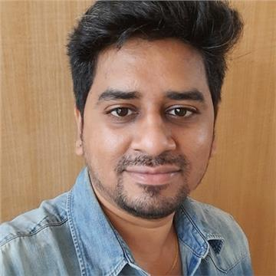
ARUN SINGH G SENIOR ASSOCIATE - 817840@cognizant.com
PROFILE SUMMARY
With over 10+ years of experience, including RPA, Python and Gen AI. I expertise in automation, process optimization, and project management.
INDUSTRIES
Life Science
Pharmaceutical Clinical Trials
Finance
HR
TECHNICAL SKILLS
UiPath Products
Python – Django, Flask, Pandas
Power BI and Tableau
Kubernetes
AWS/Azure
CERTIFICATIONS
RPA Solution Architect(UiPath)
Python Certifications(Udemy)
EDUCATION
MCA from Anna University – 85%
Work Experience
Utilizing a robust foundation in automation and process enhancement, I developed over 50 UiPath bots that collectively reduce annual Average Handling Time (AHT) by over 10,000 hours, thereby substantially boosting return on investment (ROI).
I created multiple reusable components that improved system performance, reduced downtime, and lowered expenses by adhering to best practices and implementing innovative concepts. Collaborating closely with stakeholders, I ensure a deep understanding of business goals, develop comprehensive process designs, and implement solutions that enhance productivity, accuracy, and scalability.
In addition to my technical proficiency, I assume the role of leading code reviews and mentoring junior team members, aiding in their skill development and unlocking their full potential. Recently, I concluded a successful Proof of Concept (POC) using the Test Suite functionality, enhancing the effectiveness of quality assurance and testing procedures.
I specialize in crafting web pages using HTML, CSS, and JavaScript and am well-versed in the Flask and Django frameworks for Python. I successfully designed and implemented a RESTful web service using Flask and Python, resulting in a substantial reduction in server response time and a notable enhancement in customer satisfaction.
Possess expertise in serverless architectures and containerization technologies, such as Docker and Kubernetes. Played a key role in facilitating the development and deployment of a service mesh solution based on Kubernetes. Additionally, generated numerous dashboards and reports using UiPath Insights, Power BI, and Tableau to visually represent business data for stakeholder meetings.
Possess proficiency in configuring and managing Amazon Web Services, including S3, IAM, and EC2. Actively engaged in establishing Continuous Integration/Continuous Deployment (CI/CD) pipelines using Git and Azure DevOps.
Participated in the RPA UiPath Hackathon and Microsoft AI Odyssey Campaign. Within the UiPath community forum, an open platform for discussing automation challenges, I've made significant contributions by addressing various automation issues.
Engaged in IBM's Gen AI Watson-X initiatives, I crafted an AI model tailored to leverage company-specific data for processing user inputs. The model incorporates an NLP component to generate responses to user queries. Additionally, I innovatively designed a chatbot solution utilizing ChatGPT and UiPath to assess the percentage match of a CV to a job, facilitating additional screening processes.

